Slide 1
BSEN 5250/6250
Lecture 2
Numerical Solution to Rate Equations:
Theory of Euler Integration
Reading: Chapter 5 of Computer Simulation in Biology by
Keen and Spain

Slide 2
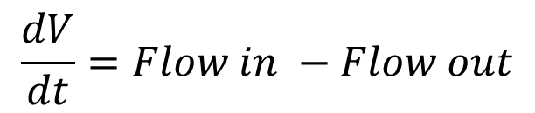
Introduction
Quantifying rates of biological processes often requires solving complex non-linear differential equation
It is often impossible to solve these equations analytically, so numerical techniques are often employed
Numerical techniques are “approximate” and have error associated with them
$$\frac{dV}{dt}=Flow in −Flow out$$
Flow in
Flow out

Slide 3
Objectives
Derive the Euler equation from the Taylor Series Expansion
Estimate error associated with the Euler equation
Learn why numerical techniques are often preferable to analytical techniques for solving many biological process equations

Slide 4
Taylor Series
F(t+dt)
If a function and its derivatives are continuous on the interval t to t+dt, then the value of the function at t+dt is given by the infinite series called the “Taylor Series Expansion”
F(t)
t
t+dt
Remainder
or error term

Slide 5
Taylor Series – Remainder Term
Where
t < θ < t+dt
Error is a function of the time step size!

Slide 6
Taylor Series – Order
The order of the Taylor Series Expansion is defined by the number of terms used in the expansion and the order is the highest derivative used
0th order
1st Order
2nd Order

Slide 7
Taylor Series – Order
Taylor series expansion is an infinite series, thus you cannot express every term
Higher order terms are truncated by necessity
Truncating terms introduces error in the solution
Understanding truncation error is important in solving biological problems

Slide 8
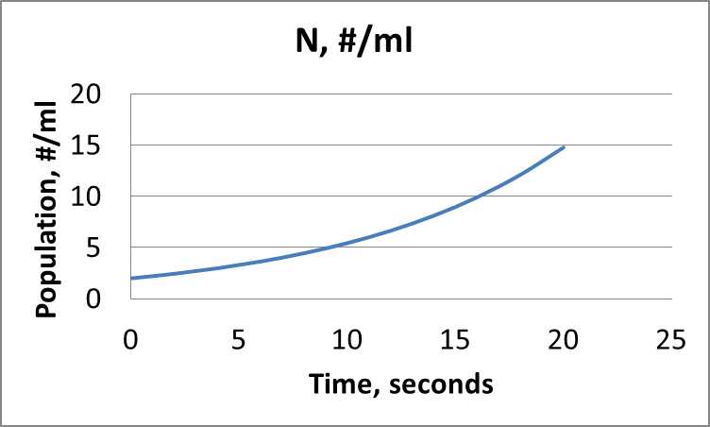
Truncation Error in Taylor Series
Given: A bacterial population grows according to the equation
Where
N(t) = population at time t, #/ml
t = time, min
N₀ = initial population at time t=0, #/ml
k = reproduction constant, 1/time
Find: Taylor series estimate of the population at time t=1 minute and k=0.1/minute using 0th, 1st, and 2nd order Taylor Series expansion about time t=0 minutes. N_{o} = 2/ml

Slide 9
Taylor Series – Roundoff Error Example
Term 1
Term 2
Term 3
N(t+dt) = n(t) + N’(t)dt N’’(t)
+
dt²
2!
1
2!
N₀e^{(0.1*0)}
kN₀e^{(0.1*0)} dt
k²N₀e^{(0.1*0)} dt²
2e^{(0.1*0)}
(0.1)(2)e^{(0.1*0)}(1)¹
(0.5)(0.1)²(2)e^{(0.1*0)} (1)²
2.0
0.2
0.01
2.0
2.2
2.21
Exact Answer is 2.21

Slide 10
Taylor Series – Roundoff Error Example

Slide 11
Euler’s Equation
If the Taylor Series is truncated after the 1st order term, the result is the Euler equation
Error associated with Euler’s Equation
Euler’s Equation
Truncation error in Euler’s equation is proportional to the square of the time step

Slide 12
Euler’s Equation (Graphically)
dt
Run
f(t+dt)
Rise
f(t+dt) – f(t)
f(t)
t
t+dt
1st Order Taylor Series Expansion

Slide 13

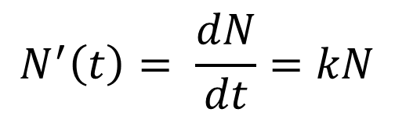
Comparison of Analytical and Numerical Solutions
Example: Bacteria Population
$$N^{′}\left(t\right)= \frac{dN}{dt}=kN$$
Governing Equation
Analytical Solution
Numerical Solution
Where
N(t) = population at time t, #/ml
t = time, min
N₀ = initial population, 2/ml
k = reproduction constant 0.1/min

Slide 14
Example: Bacteria Population
Euler’s Equation
Initial and Boundary Conditions
N(t=0) = 2/ml
k = 0.1/min
dt = 1 min
Time, min Pop., No./ml
0 N(t=0) = 2
1 N(t=1) = 2 + 0.1*2*1 = 2.2
2 N(t=2) = 2.2 + 0.1*2.2*1 = 2.42

Slide 15
Comparison of Analytical and Numerical Solutions

Slide 16
Computing Error Between Analytical and Numerical Solution
Percent Error can be computed by:

Slide 17
Error between analytical and numerical solution for time t=10 min

Slide 18
Order of Magnitude of Error for Euler Method
Order of magnitude is related to square of step size
Error associated with Euler’s Equation
Euler’s Equation

Slide 19
Examples of Complex Equations
Theoretical mathematical models are often not sophisticated enough to describe complex biological processes
Altering theoretical equations to add “reality” to the equation can lead to equations that cannot be solved using analytical techniques
Numerical techniques are important in solving equations that govern biological processes

Slide 20
Examples of Complex Equations
Numerical Techniques are used when:
Equations describing the system may be too complex to solve analytically
The constants in the equations may change over time or space
Rate equations or constants may be measured values rather than computed values

Slide 21
Example: Bacteria Population
Where
N(t) = population at time t, #/ml
t = time, min
N₀ = initial population, 2/ml
k = reproduction constant that varies as a function of temperature, 1/time

Slide 22
Example: Bacteria Population
Let k = k_{opt} * kfac
Where
K_{opt} = 0.1/min
kfac = -0.005*T² + 0.2*T – 1
if T < 7 then Kfac = 0
if T > 33 then Kfac = 0

Slide 23
Analytical Formulation
This equation can be solved analytically. However, the rule that sets kfac to 0 if kfac is negative cannot be incorporated into the analytical solution
Secondly, temperature is a time series measured input to the model that affects the state of the system. Thus, it does not conform to an analytical solution.

Slide 24
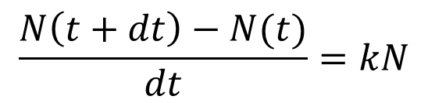
Numerical Formulation
$$\frac{N\left(t+dt\right)−N(t)}{dt}=kN$$
This equation can be solved for each time step, and the rule that sets kfac to 0 if kfac is less than 0 can be incorporated into the logic of the computer model. Thus, the numerical approach allows us to add reality to the model in a relatively easy manner.

Slide 25
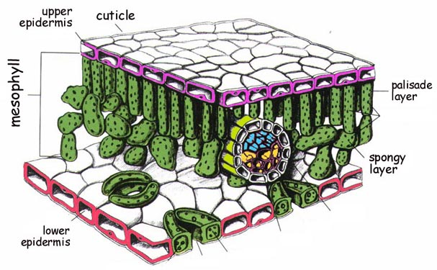
Example – Diffusion of Water from Leaf
Transport of CO₂ into the guard cell of a leaf occurs by diffusion.
When the guard cells are open, water diffuses out of the leaf
Water diffuses 1.56 times faster than CO₂
Guard Cell

Slide 26
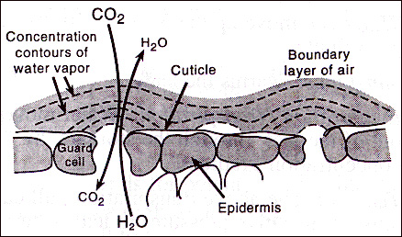
Governing Equation
J = flux of water molecules, kg/sec
D = diffusion coefficient, m²/sec
A = cross sectional area, m²
C_{in} = Conc. of water inside cell, kg/m³
C_{out} = Conc. of water outside cell, kg/m³
dx = thickness of cell wall, m

Slide 27
Analytical Formulation
Integrating gives an explicit equation for mass over time

Slide 28
Analytical Solution
For a typical condition, the parameter values are:
Mass(t) = mass, kg
t = time, seconds
D =2.4 * 10⁻⁵ m²/sec
A = 8.0*10⁻¹¹ m²
C_{in} = .022 kg/m³
C_{out} = 0.11 kg/m³
dx = 2.5*10⁻⁵ m

Slide 30
The Problem
How do you solve this equation for mass if D or C changes over time?
This real world situation requires a numerical solution

Slide 31

Simple Diffusion Model
Use Euler’s method to develop an equation to compute mass of water lost from the leaf assuming that D and C may vary over time

Slide 32
Simple Diffusion Model
M = mass of water
Note, D and C values at time t are used to estimate M(t+dt)

Slide 33
Summary
Numerical techniques are required to solve many real world biological equations
The Euler method is one of the simplest numerical techniques used to solve rate equations
Errors associated with the formulation of Eulers method are proportional to the square of the solution step size
Reducing step size increases numerical accuracy due to truncation error

